Slide 1

Movie Box Office Revenue Analysis
Miguel Ari, Grace Barnett, Crisaldry Brito, Angela Narag, Darya Naymon

Slide 2
Project statement
The purpose of this project is to analyze box office movie revenue from 2000 to 2022 and identify key factors that contribute to a movie’s success.
The project aims to address the need for understanding the underlying factors that drive box office success by creating an interface that would allow the user to sort through movie data across a specified timeline using various pre-selected metrics.
Notes:
Angela - speaking points
The goals and objectives of the project are to create an interactive dashboard using JavaScript and HTML that showcases different data visualizations of movie box office revenue against other indicators.
Our hypothesis was that there were certain factors that impact box office revenue: we chose to look at budget, directors, certification/ratings, language, and genre - as factors that impact how profitable a movie is.
The project's key activities include data collection and analysis, API development using Python Flask, HTML/CSS and JavaScript development, and database integration. The project's deliverable is a story told through data visualizations that help to identify the key factors behind box office success.

Slide 3
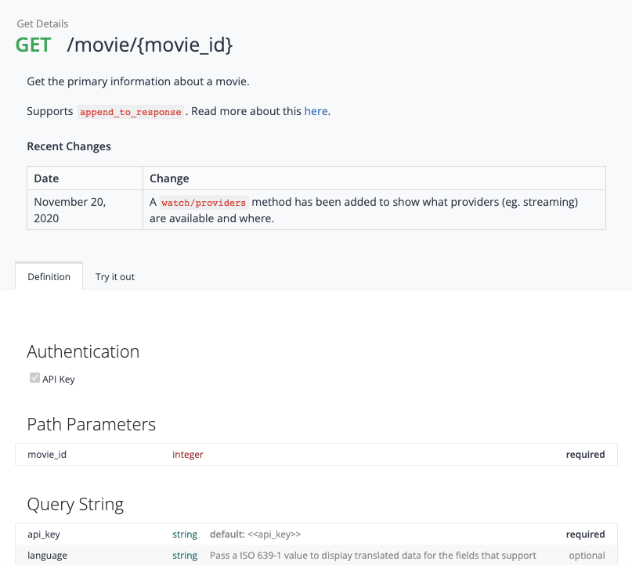
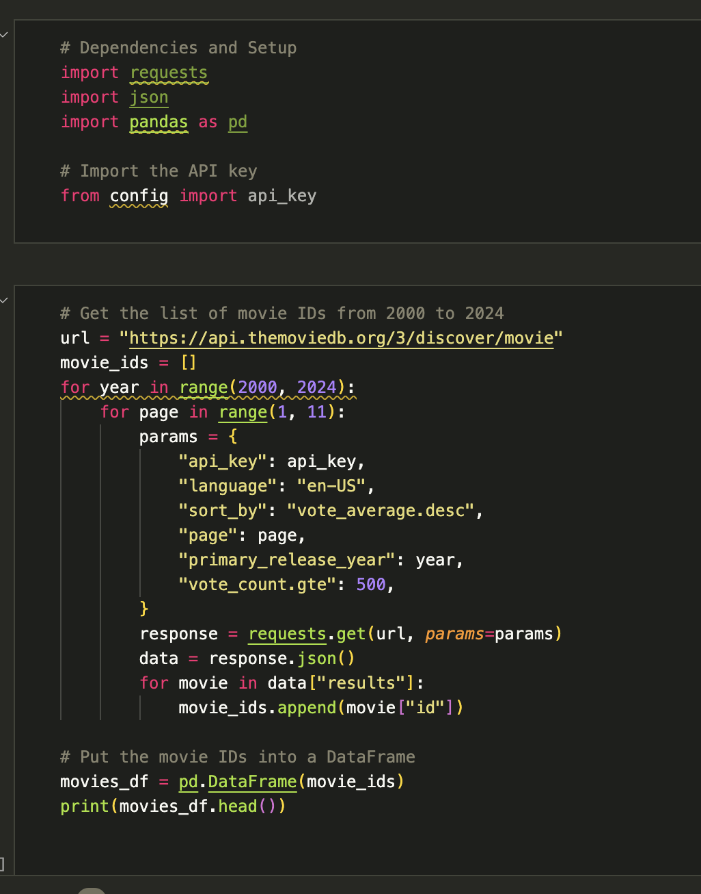
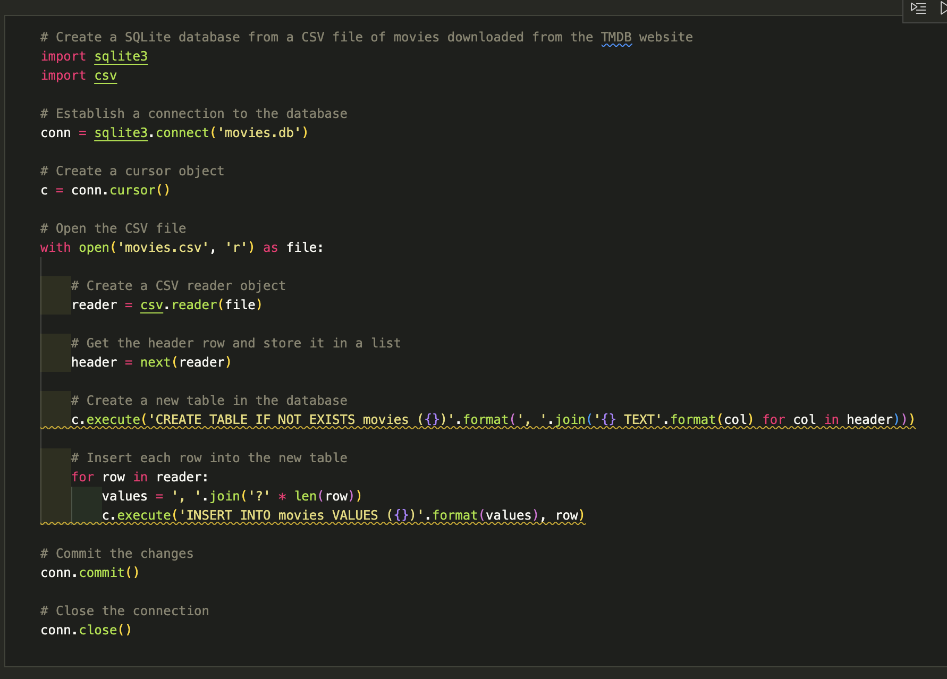
Dataset
We used TMDB API to access a vast amount of information about movies and TV shows, including metadata, ratings, and reviews. Timeframe: 2000-2023. Size: 4000+ data points.
Once we obtain our API key, we sent HTTP requests to the API, parsed the data, and stored it into a SQLite database.
Some of the attributes we retrieved include:
Movie Title
Genre
Language
Budget
Box Office Revenue
Rating
Director
Certification (G, PG, PG-13, NC-17, R)
Runtime
Movie Popularity
Notes:
Miguel
The project's specific requirements include creating a dashboard page with multiple charts that update from the same data, using at least one JS library that was not covered in the course, having a dataset with at least 100 records, and including user-driven interaction such as menus, dropdowns, and textboxes. The final visualization should ideally include at least three views.

Slide 4
How
The project's key activities include data collection and analysis, API development using Python Flask, HTML/CSS and JavaScript development, and database integration.
app.py - sets up a Flask application and defines several routes that render different HTML templates. The templates are used to display different views of data visualizations on the frontend. The code also defines API endpoints that retrieve data from the ‘movies.db’ SQLite database. Then the retrieved data is converted into to a list of dictionaries and returned as a JSON.
index.html - displays a webpage that contains hyperlinks that link to other pages of data visualizations within the same application
JavaScript files - each project team member created a JavaScript file to create data visualizations that help to identify the key factors behind box office success.
HTML files - each project team member also have their own HTML file to display their data visualizations
Notes:
Darya

Slide 5
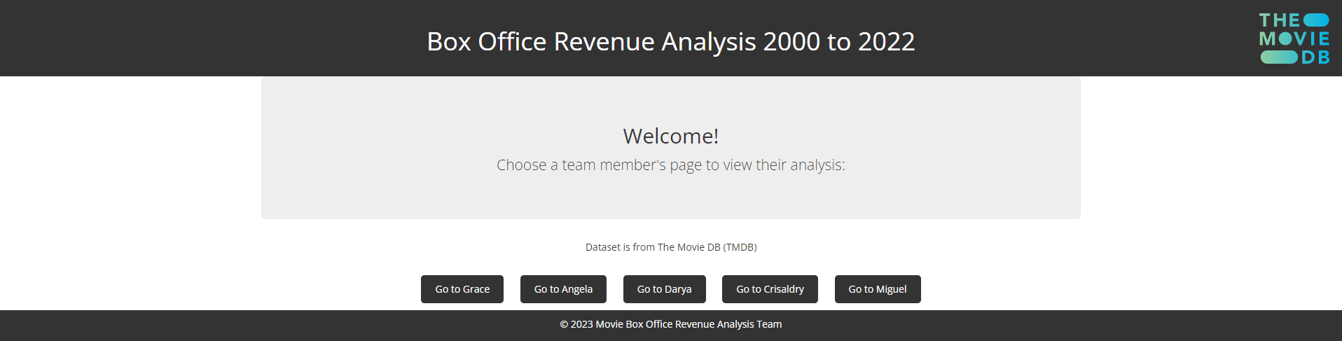

Slide 6
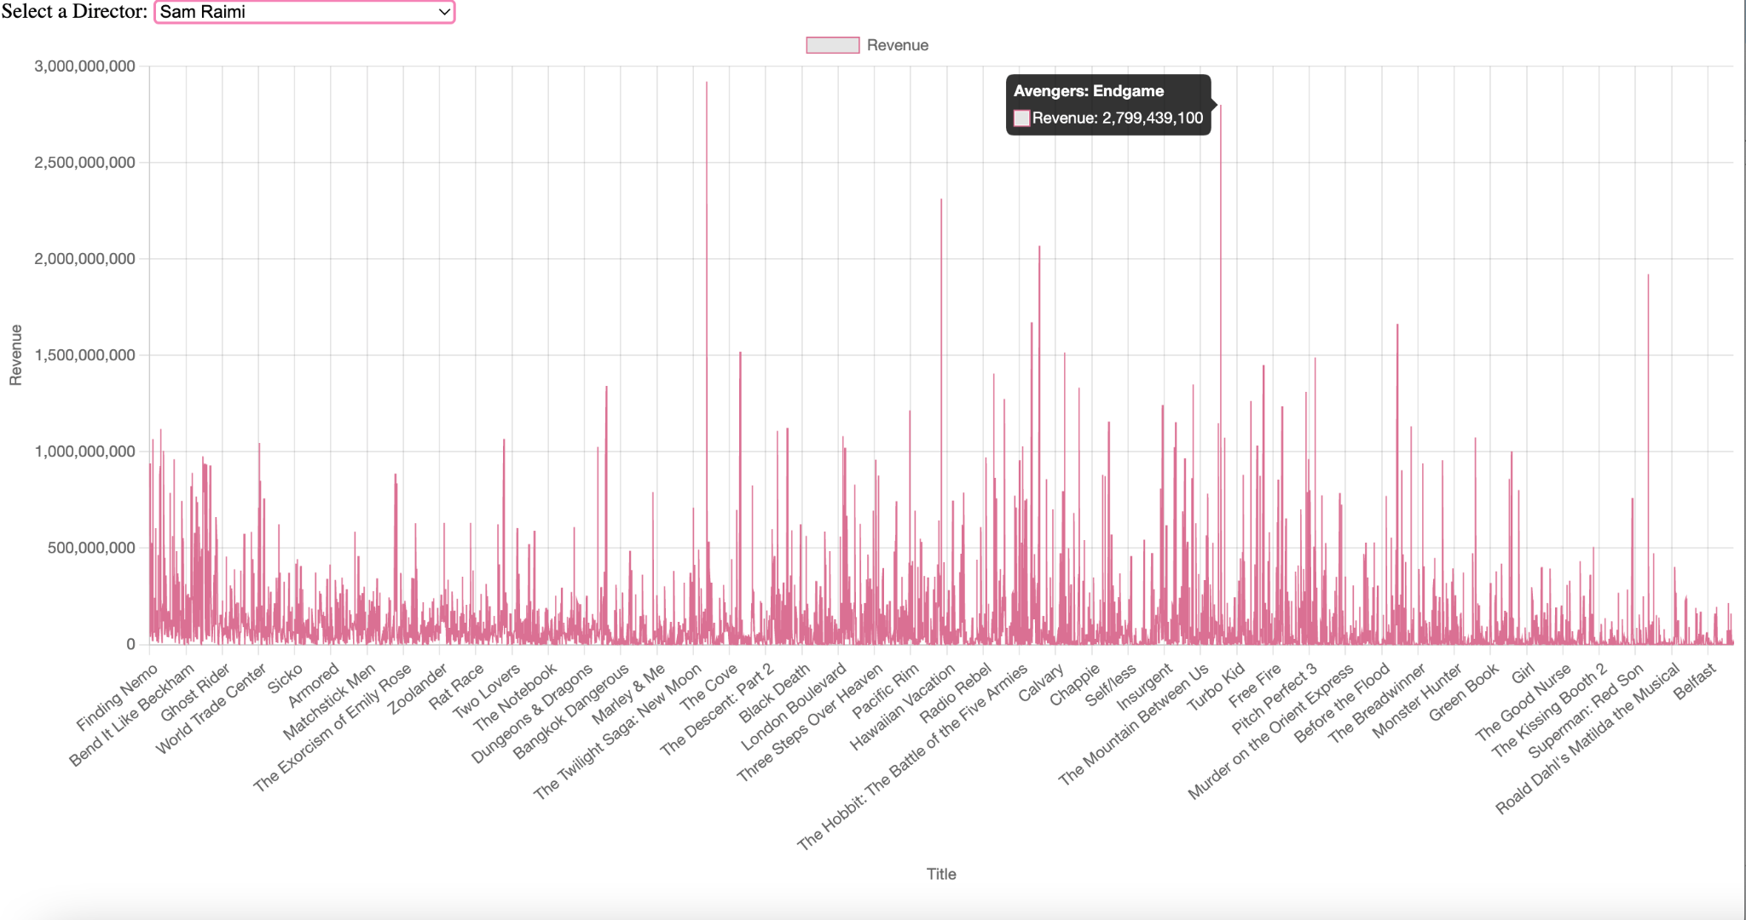
Director vs. Revenue
Screenshot of viz
This chart compares revenue generated per title, with filters per director in order to look at how name brands impact the success of a movie at the box office.
The chart groups movie titles with the directors that created them. The old chart is destroyed each time a new selection is made.
Notes:
Grace

Slide 7
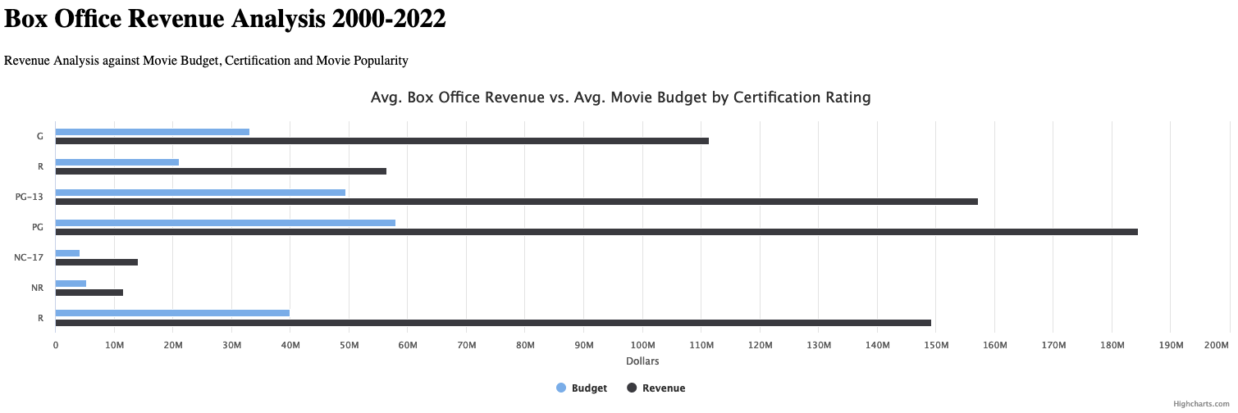
Revenue | Certification | Ratings
The chart compares the Box Office Revenue vs. Budget within the Movie Certification: G, R, PG-13, PG, NC-17, NR, R.
The code filtered the budget and revenue for each certification group and calculates the average revenue and budget for each certification group.
The extracted and aggregated data is then used to create a Highcharts chart that maps average revenue vs average budget for each certification rating.
Notes:
Angela

Slide 8
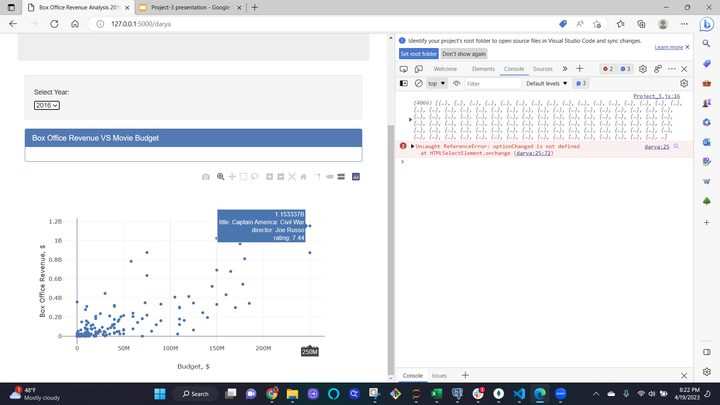
Box Office Revenue vs Movie Budget
Movies need money! That’s an irrefutable fact. And it’s a goal of the investor to get a positive return. I decided to look at how film budgets correlate to box office revenue.
Interactive chart offers a dropdown for years from 2010 to 2022 and each year movies are presented in scatter plot. Dots stand for individual movies by pointing at each information: title, director, and rating becomes visible.
Notes:
Darya

Slide 9
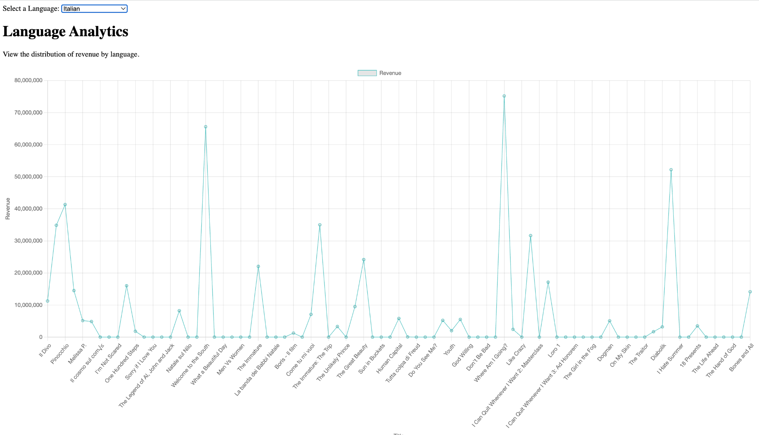
Revenue by Movie and Language
Foreign-language movies have gained popularity in recent years.
Countries around the world are consistently developing their Movie and Film industries in their native language, and their popularity are surging worldwide.
Netflix reporting that “In 2022, more than 70% of global viewing came from members watching a title from a country other than their own.”
Foreign-language films are an important investment as the more languages offered, the bigger the target audience both domestically and internationally.
Source: Netflix, Streaming the World: Popularity of Non-English Language Stories on Netflix Surges, (10 March 2023).
Notes:
Crisaldry

Slide 10
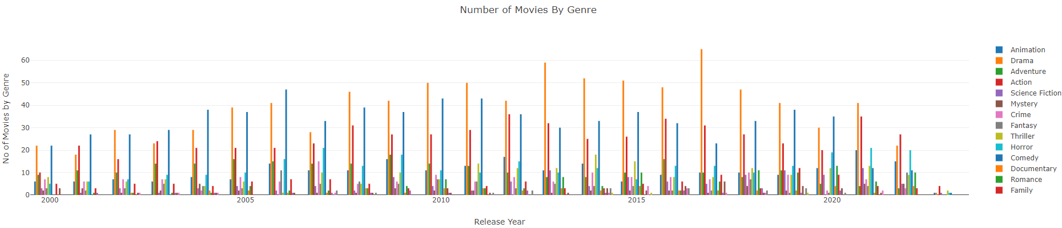
Movie Industry Trends by Genre
Understanding industry trends can help filmmakers and investor make informed decisions and maximize their returns.
1st & 2nd Plots: We looped through the dataset and group it in two different dictionaries for genre and release year. The key values for the release year dictionary is then used for the x axis, while the genre dictionary is mapped to filter by release year and a total count for each genre is obtained for each year.
3rd Plot: The dataset is first grouped by genre and then by release year. We looped through the genre dictionary to obtain the total revenue and movie count for each genre to then obtain an average revenue per movie.
Notes:
Angela

Slide 11
Conclusion
Based on the factors analyzed, although we cannot draw an exact conclusion on what determines the ‘monetary success’ of a movie.
As a group, we agree that the five factors chosen [director, genre, certification/rating, budget, and language], do play a role in how successful the films will be. Within each of the factors, the data showed which sub-factors were the most popular [for ex. which director, language, genre].
For instance, our analysis show that budget and box office revenue show positive correlation in each given year. When the budget increases, the value of revenue in a similar fashion.
Of the different certifications (G, R, PG-13, PG, NC-17, NR, R), PG and PG-13 had the highest revenues in the last 20 years.
Highly rated movies do not always equal box office success, except for Avatar (the first one) which was rated high one of top three earning movies in the last two decades.
The name of a director doesn’t necessarily impact the box office success of a movie, however it is likely that more well-known directors may be given larger budgets and more promising projects.
Just over half of all films released over the past twenty years are Dramas (51.6%). Other popular genres include Comedy (28.4% of movies made), Action (12.4%), Romance (11.6%), Adventure (11.2%) and Horror (10.6%).
Notes:
Grace

Slide 12
In summary…
Things we struggled with:
Understanding the TMDB API configuration in order to get our data
Deciding on which factors to include in our analysis
Finding the correct chart to showcase our data and hypothesis
Working with a new JavaScript library
Using Flask to put together and render each person’s web pages
Ensuring a connection between the Database, Flask API, HTML and JavaScript
Things we enjoyed:
Seeing our charts come to life and our code work
Learning new tools and applying them to real-life dataset
Working with a team! Seeing the way different people approach problems is a great way to learn.
Being able to improve the way we interact with ChatGPT to create or debug code.
Notes:
Crisaldry

Slide 13
Thank you!

